Slide 1
Welcome
FIS-OfficeMate-Prototype
Team- Fantastic Five
Madhumeets Kulkarni
Vaishali Purohit
Manisha Bapat
Anuja Kurane

Slide 2
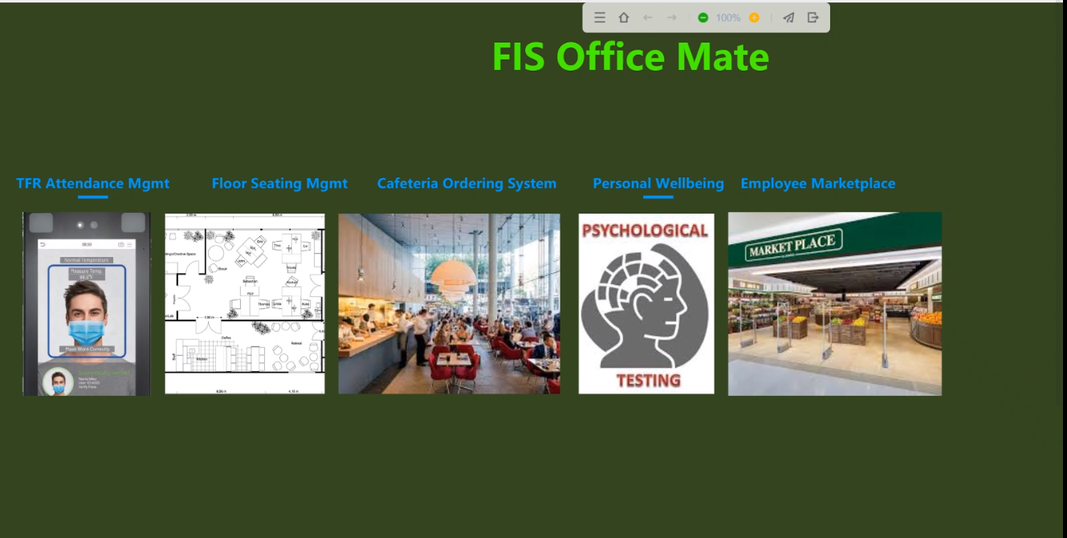
FIS OfficeMate- Main Page

Slide 3
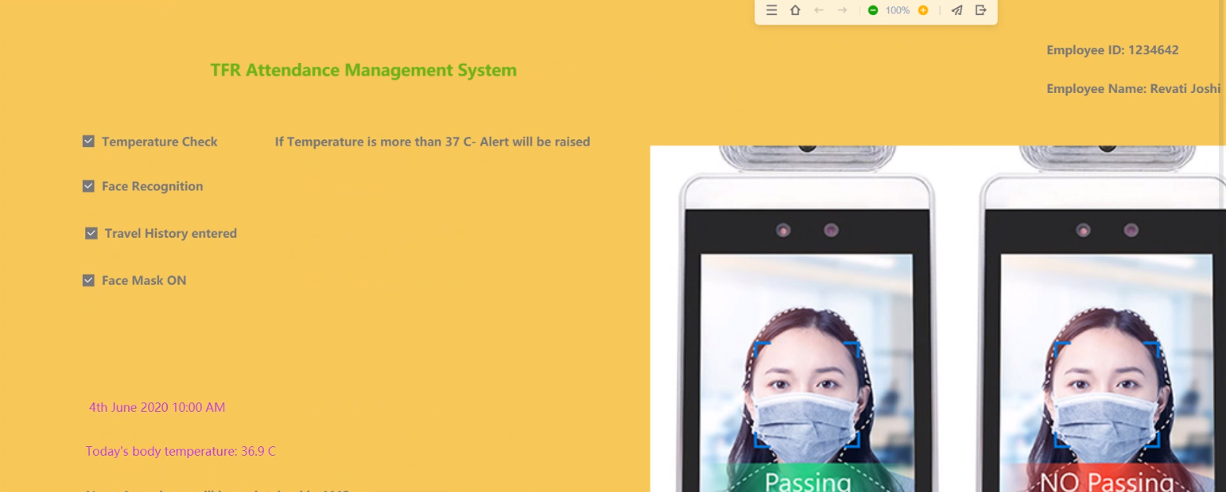
TFS Attendance Management System

Slide 4
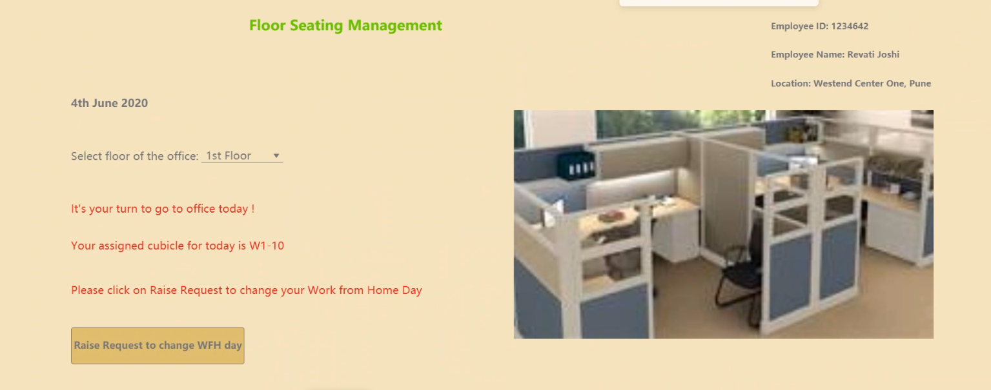
Floor Seating Management

Slide 5
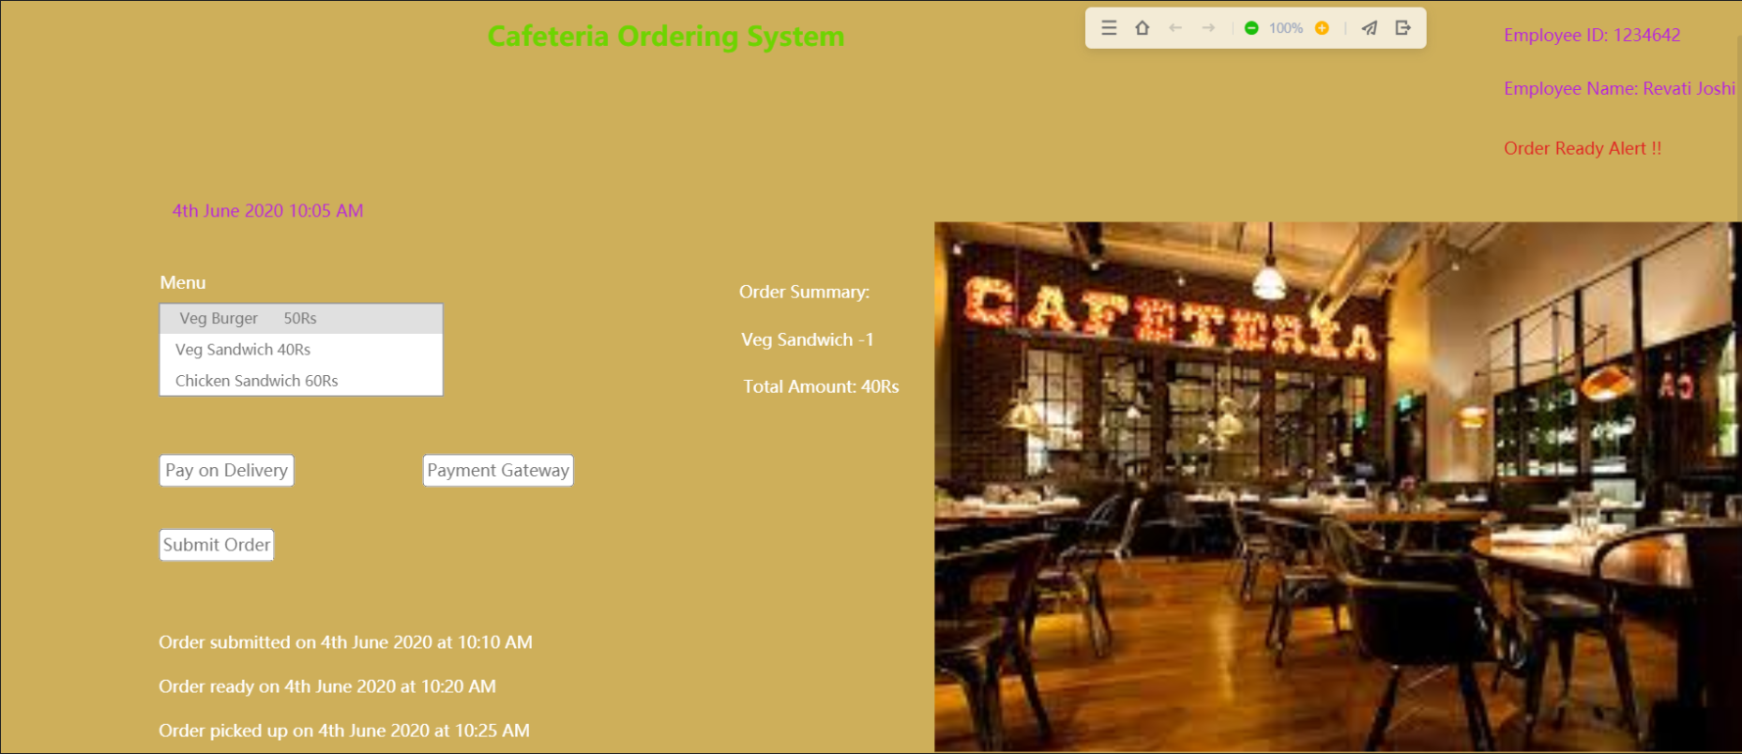
Cafeteria Ordering System

Slide 6
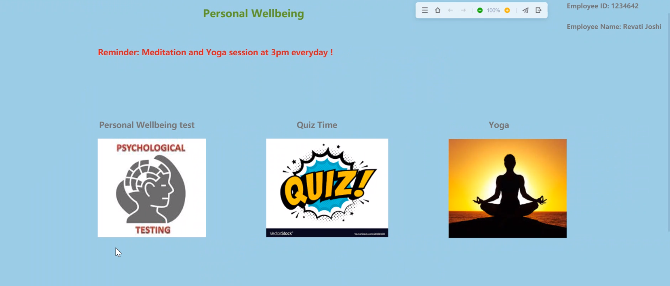
Employee Wellbeing

Slide 7
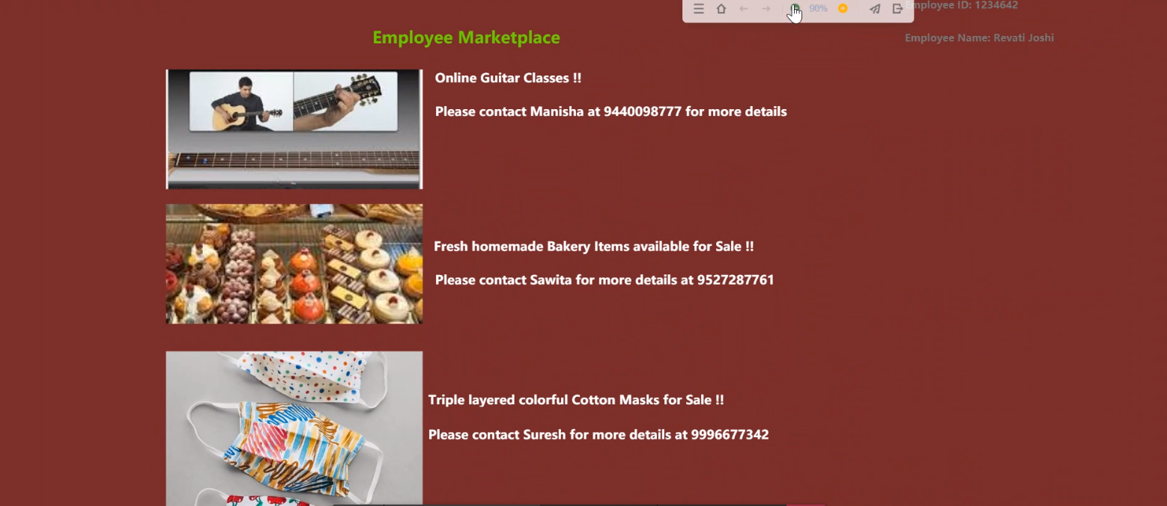
Employee Marketplace

Slide 8
Q&A

